Slide 1

HOME AUTOMATION USING BOLT IOT

Slide 2
INTRODUCTION
Over the past few years, the Internet of Things (IoT) has been an evolving trend for most startups. Also, many large and medium enterprises rely on IoT products for a coherent solution. But the fact is, the IoT is complex and there are endless problems while building an IoT product. According to Verizon’s report ‘State of Market: Internet of Things 2016,’ “Creating, implementing and managing IoT applications is a complex process involving sensors, mobile devices, secure network connectivity, storage, Big Data analytics, ability to scale new services, and on-going integration and fine-tuning. Most enterprises, regardless of size, do not have all of these capabilities and skills in-house to make the IoT a reality.” This proves to be a major drawback of IoT applications, which is why the IoT is still out of reach for many enterprises.

Slide 3
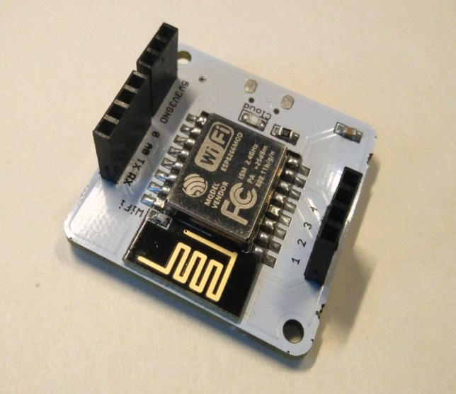
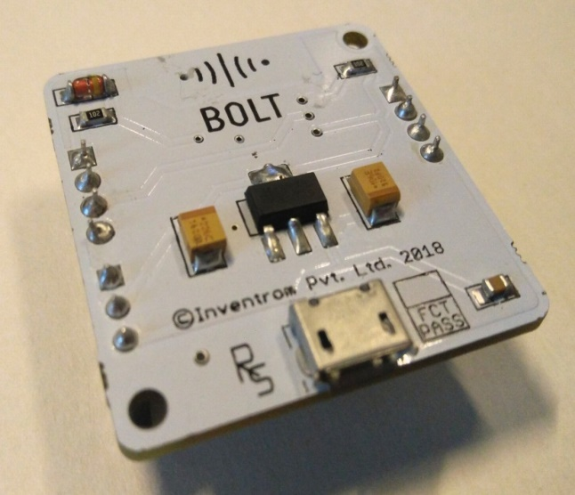
BOLT

Slide 4
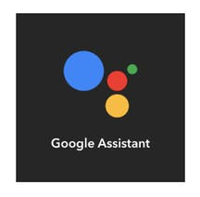
Applications of Bolt :
1.Controlling the electrical appliances through the cloud platform.
2.Controlling the LED through google assistant.
3.And using Proximity sensor.
1.We have used the java script to control the electrical appliances i.e. light , fan and we have created the web page which is very simple and easy for the users who are using it. And also we can control it by using our smart phone.
2.Using the website ifttt.com we have created two triggers using google assistant those are “turn on led” and “turn off led”. So that by giving these commands to google assistant it will turn on and turn of the lights respectively.

Slide 5
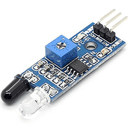
3. And also we have included a little usage of Proximity sensor i.e. this sensor senses the movements of a person and hence the lights gets turned on . This sensor can be implemented in our homes near the door so that it plays a major role in saving electricity.

Slide 6
Controlling devices :
You can control your devices by just writing few lines of code :
var dual =dualButton("left");
dual.first_button({name:“BULB1 OFF", action:"digitalWrite",
pin:“1", value:"LOW", bgcolor:"blue",
shape:"rectangle", text_color:"white"})
dual.second_button({name:“BULB2 ON", action:"digitalWrite",
pin:“1", value:"HIGH", bgcolor:"black",
shape:"rectangle", text_color:"white"})
var dual2 =dualButton("right");
dual2.first_button({name:“BULB2 OFF", action:“digitalWrite",
pin:“2", value:“LOW", bgcolor:“Ornage",
shape:"circle", text_color:"black"})
dual2.second_button({name:“BULB2 ON", action:“digitalWrite",
pin:“2", value:“HIGH", bgcolor:“PURPLE",
shape:"circle", text_color:"White"})

Slide 7
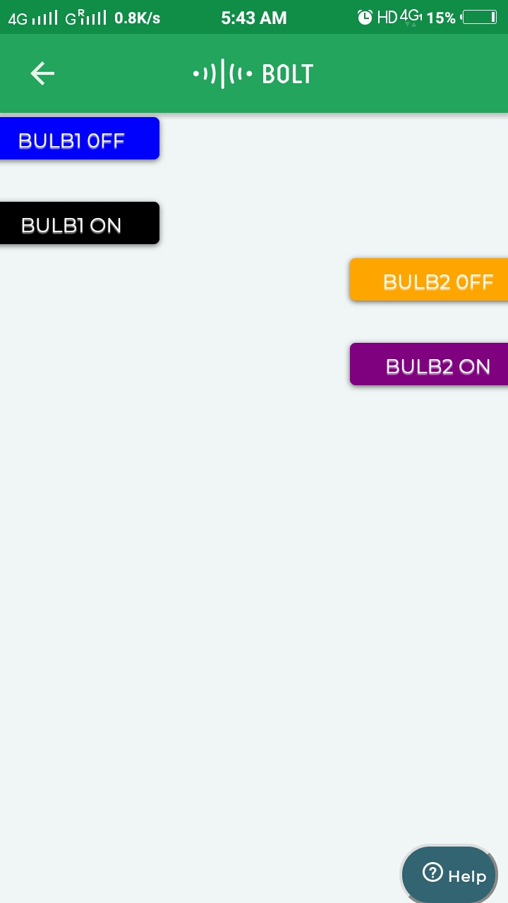
Controlling device :

Slide 8
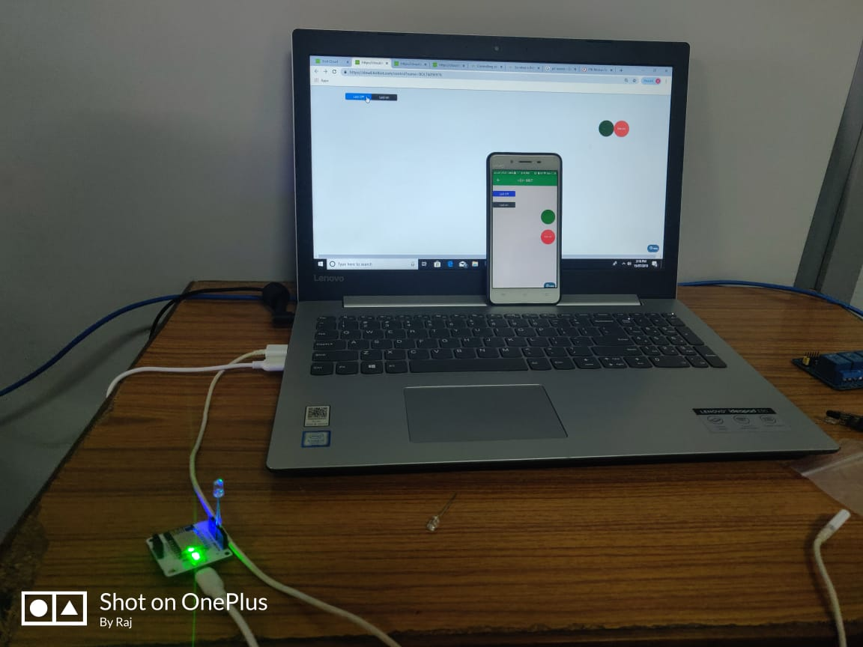
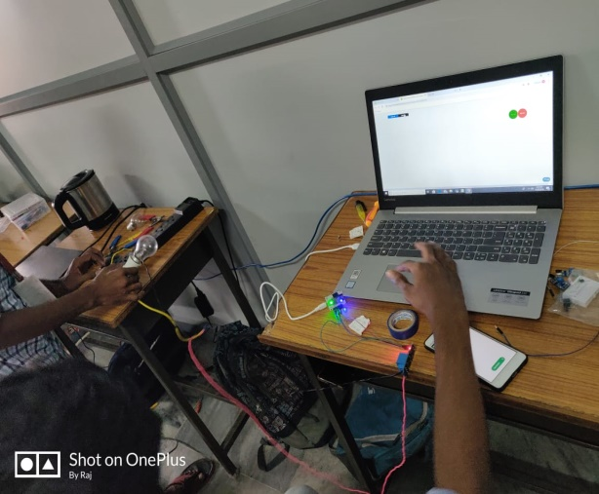
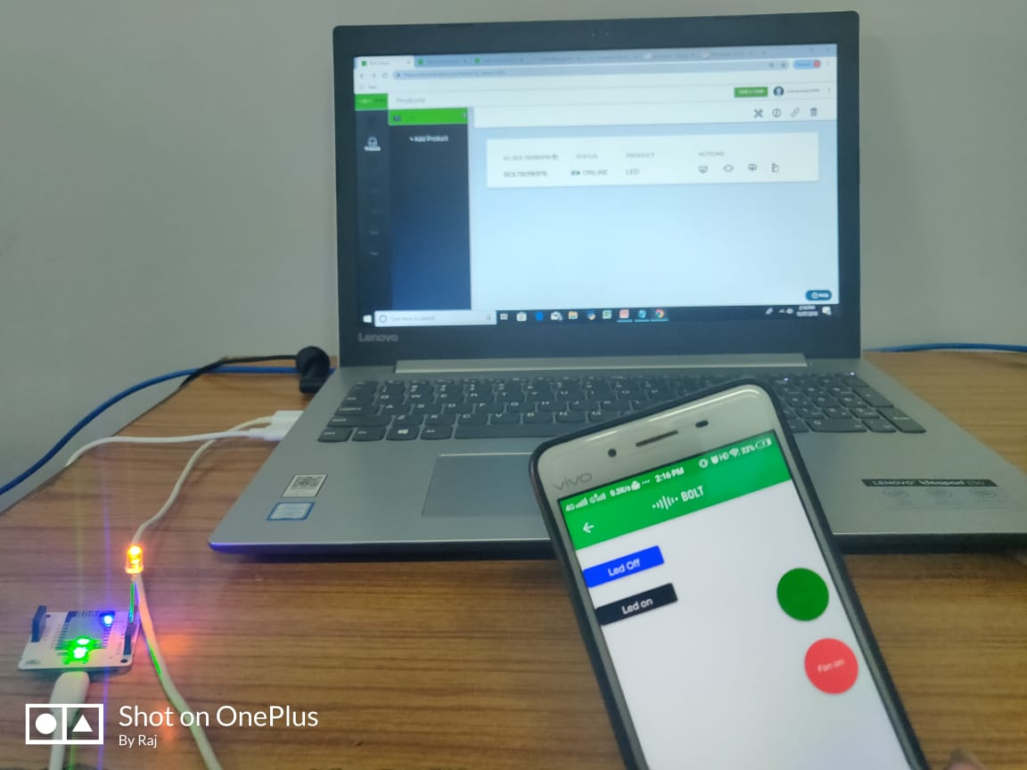
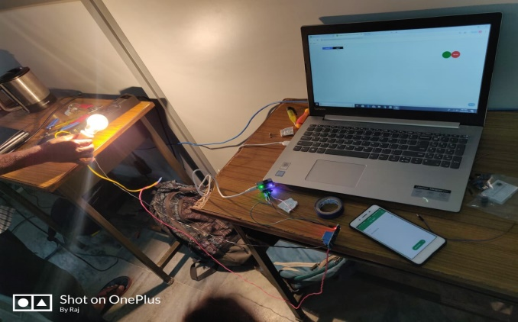
RESULT
Using Bolt App in mobile
Using Web Site

Slide 9
CONCLUSION
Through this project we have concluded that we can control electrical appliances which are used in our home like fan, light, AC, remote etc. through Bolt interface.
There are so many ways to control this appliances. We have chosen three among them :
Through the link(https://cloud.boltiot.com/remote/01ee6c14-e676-4e12-bb99-bc6226030791/digitalWrite?pin=0&state=HIGH&deviceName=BOLT6096976); i.e., Home Automation Using Bolt Iot.
Through Google assistant.
Proximity sensor.
At last we have concluded that in place of aurdino we can use Bolt Iot Platform which is available at low cost and also has better applications equal to aurdino and raspberry pi. It also have the on-board storage capacity with SD card support. One of the best feature of Bolt is its cloud.

Slide 10
THANK YOU

